Slide 1
Business & Networked Communication Skills
Prepared by: Dr. T.M.Venthan

Slide 2
Introduction to ICT Professional Practice
ICT Professional Practice refers to the standards, methodologies, and ethical considerations that guide the work of professionals in the Information and Communications Technology sector.

Slide 3

Definition and Scope
ICT (Information and Communications Technology): Refers to the integration of telecommunications (telephone lines and wireless signals), computers, and necessary enterprise software, middleware, storage, and audio-visual systems, which enable users to access, store, transmit, and manipulate information.

Slide 4
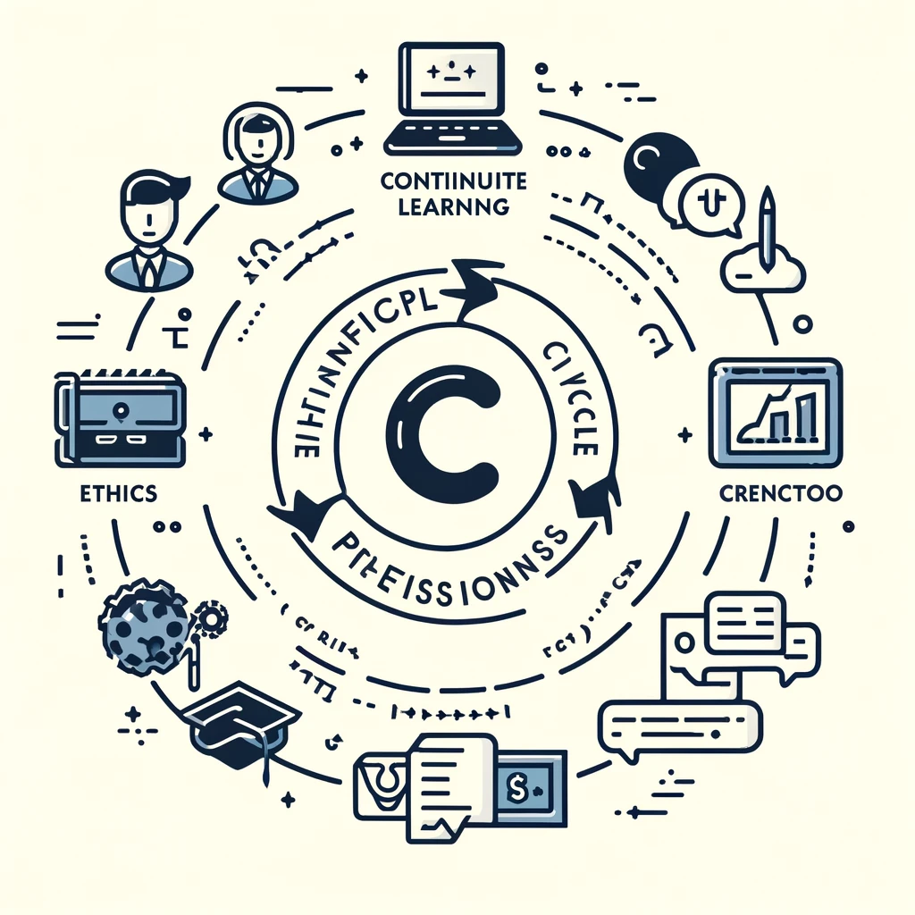
Definition and Scope
Impact on Businesses: ICT is crucial for businesses as it helps in automating processes, enhancing communication, increasing efficiency, improving customer service, and enabling e-commerce activities.

Slide 5
Communication in ICT
Communication in ICT involves the effective transmission of information and ideas between individuals and teams, utilizing various digital platforms and tools to facilitate clear and efficient exchange.

Slide 6

Fundamental Skills
Essential Communication Types: Written, oral, and interpersonal communication are crucial for effectively conveying technical concepts to both technical and non-technical audiences, fostering collaboration and ensuring alignment among stakeholders.
Written, Oral, and Interpersonal Communication: Essential for conveying complex technical concepts in a clear and understandable manner to both technical and non-technical audiences. Effective communication fosters collaboration and ensures that all stakeholders are on the same page.

Slide 7
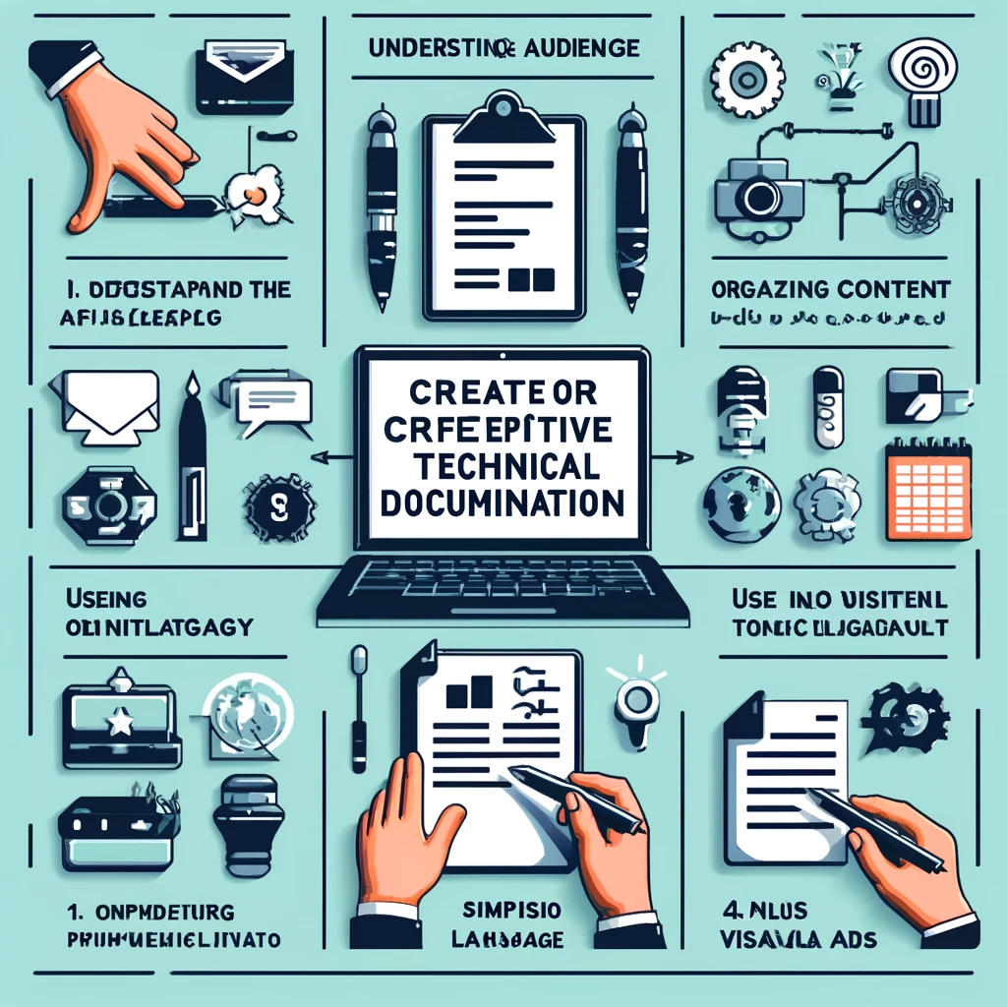
Technical Documentation
Best Practices: Creating clear, concise, and accessible documentation (like project reports, user manuals, and technical guides) is key to aiding understanding and use of a product or service.
Best Practices: Involves creating documentation that is clear, concise, and accessible. This includes project reports, user manuals, technical guides, and FAQs. Good documentation acts as a reference, aiding in the understanding and use of a product or service.

Slide 8

Presentations
Effective Delivery: Engaging presentations that cater to diverse audiences within the ICT sector are designed with attention to content relevance, visual appeal, and practiced delivery to maintain audience interest.
Crafting and Delivering: Focuses on designing presentations that are engaging and informative, suitable for a variety of audiences within the ICT sector. This includes using visuals, keeping content relevant, and practicing delivery to maintain audience engagement.

Slide 9
Business Context
Business Context in ICT relates to understanding how ICT integrates and functions within the broader business environment, including project management, team dynamics, and the strategic role of technology in achieving business objectives.

Slide 10

Understanding Business Environment
Overview: Knowledge of business operations, strategies, and objectives is crucial. ICT supports these goals by enhancing efficiency, managing data, and facilitating strategic decisions.
Overview: Familiarity with how businesses operate, including their structures, strategies, and objectives, is essential. ICT plays a crucial role in supporting these business goals through efficiency improvements, data management, and strategic decision support.

Slide 11
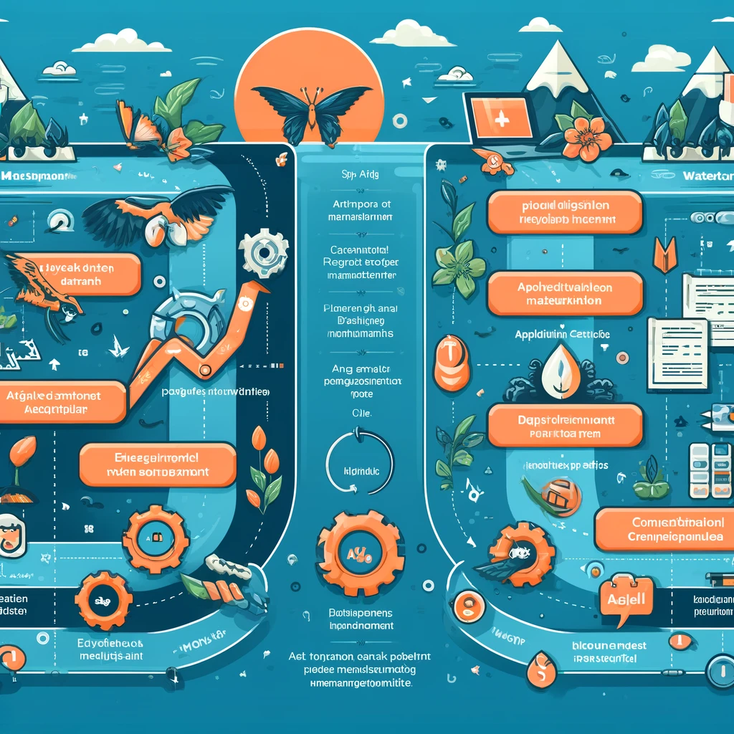
ICT Project Management
Methodologies: Agile and Waterfall methodologies cater to different project needs. Agile emphasizes flexibility and customer feedback, while Waterfall follows a sequential approach. Effective management includes planning, execution, monitoring, and closure.
Introduction to Methodologies: Understanding different project management methodologies, such as Agile for flexibility and adaptiveness, and Waterfall for sequential design, is critical in ICT. Effective project management encompasses planning, execution, monitoring, and closure to ensure project success.

Slide 12
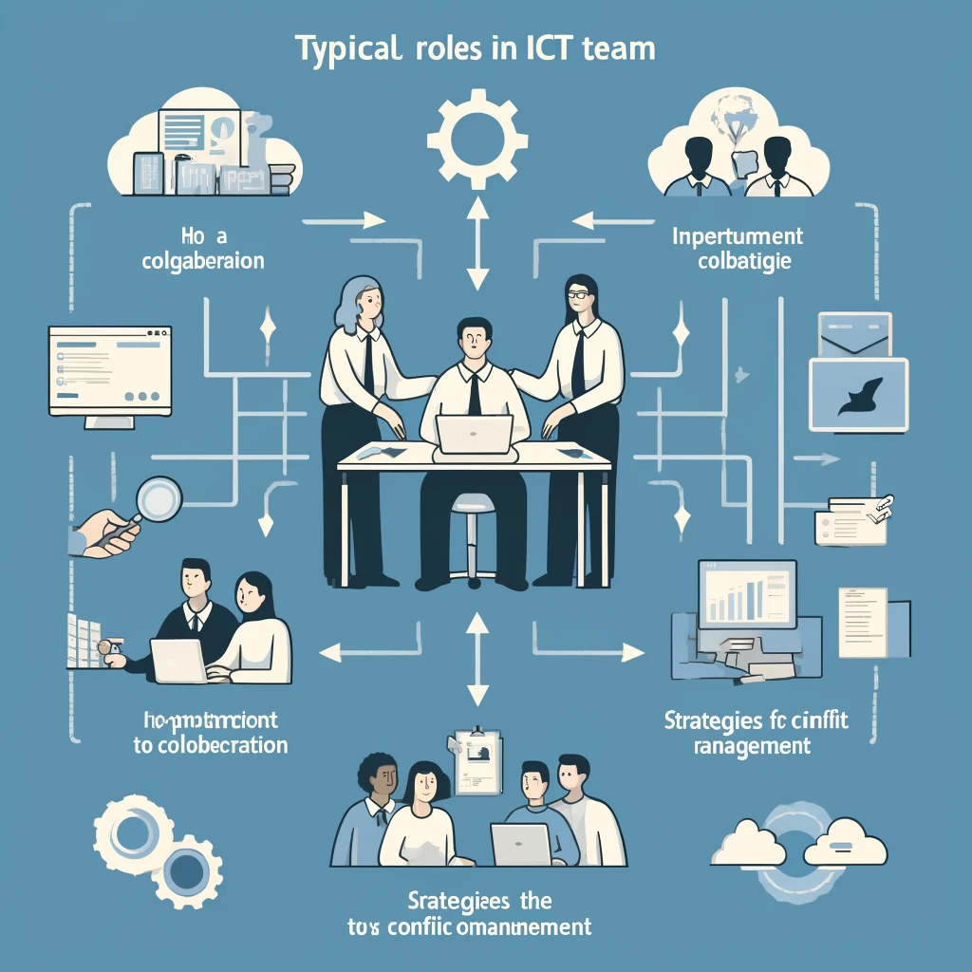
Team Dynamics
Roles and Collaboration: Identifying roles and fostering collaboration within ICT teams are key to project success. Strategies for effective communication and conflict management are essential for maintaining a productive team environment.
Roles and Collaboration: Identifying roles within ICT teams and fostering collaboration are vital for project success. Effective communication, conflict management, and a clear understanding of each member's responsibilities lead to a cohesive team.

Slide 13
Networked Communication
Networked Communication refers to the use of digital communication tools and platforms, such as emails, social media, and collaborative software, to enable efficient and effective interaction in a connected, networked environment.

Slide 14

Digital Communication Tools
Overview: Utilizing emails, instant messaging, video conferencing, and collaboration platforms enhances efficiency and collaboration, facilitating quick information exchange among team members across locations.
Overview: The use of digital communication tools like emails, instant messaging, video conferencing, and collaboration platforms is fundamental for efficient communication in today’s workplace. These tools facilitate quick information exchange and collaboration among team members, regardless of their physical location.

Slide 15

Social Media in Professional Practice
Utilization: Leveraging social media for professional networking, development, and corporate communication expands networks, shares industry insights, and enhances corporate presence and values.
Utilization: Social media platforms are increasingly used for professional networking, development, and corporate communication. They offer a vast network for connecting with peers, sharing industry knowledge, and promoting corporate values and initiatives.

Slide 16

Remote Work Communication
Strategies: Effective communication in remote or hybrid environments is key to maintaining productivity and team cohesion, involving regular check-ins, clear communication channels, and collaborative tools to foster a connected work culture.
Strategies: Effective communication is crucial in remote or hybrid work settings to maintain productivity and team cohesion. Strategies include regular check-ins, clear communication channels, and the use of collaboration tools to simulate a connected work environment.

Slide 17
Ethical and Legal Considerations
Ethical and Legal Considerations in ICT involve understanding and adhering to ethical guidelines and legal regulations related to privacy, data protection, and intellectual property rights, ensuring responsible and lawful professional conduct.

Slide 18
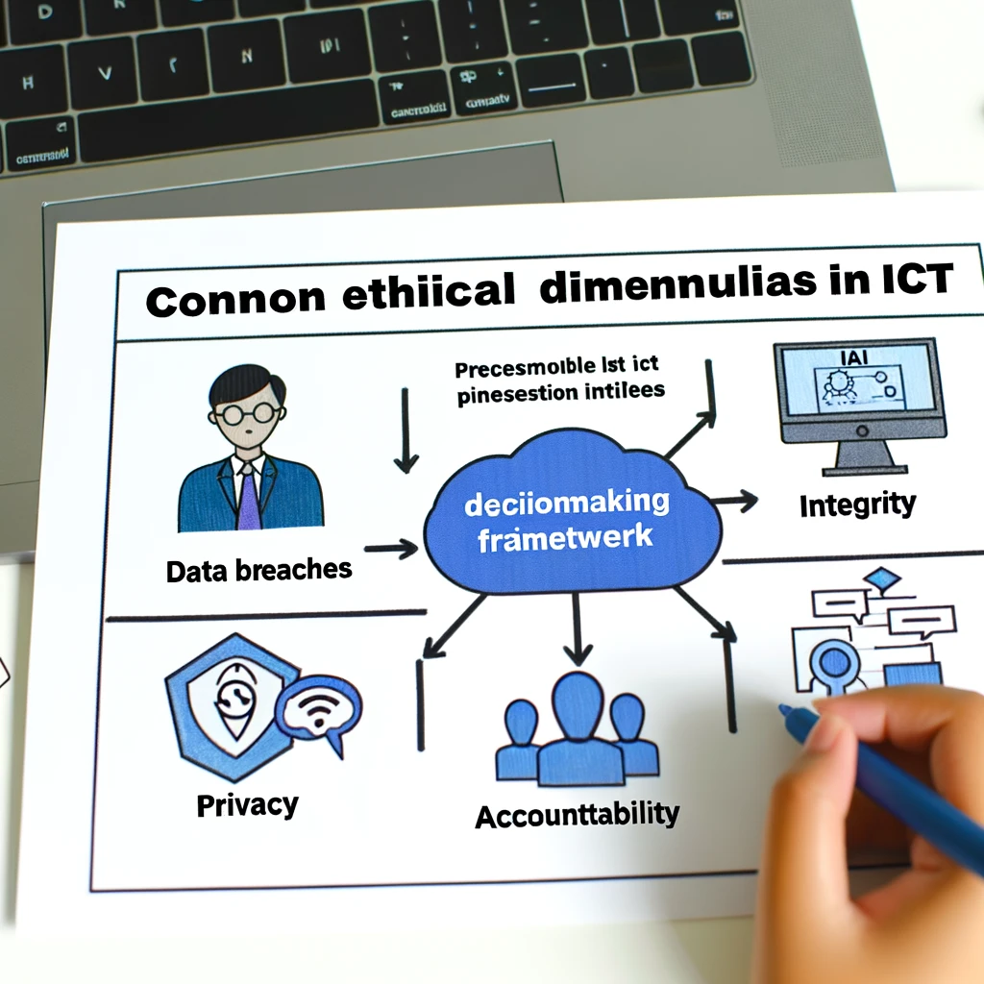
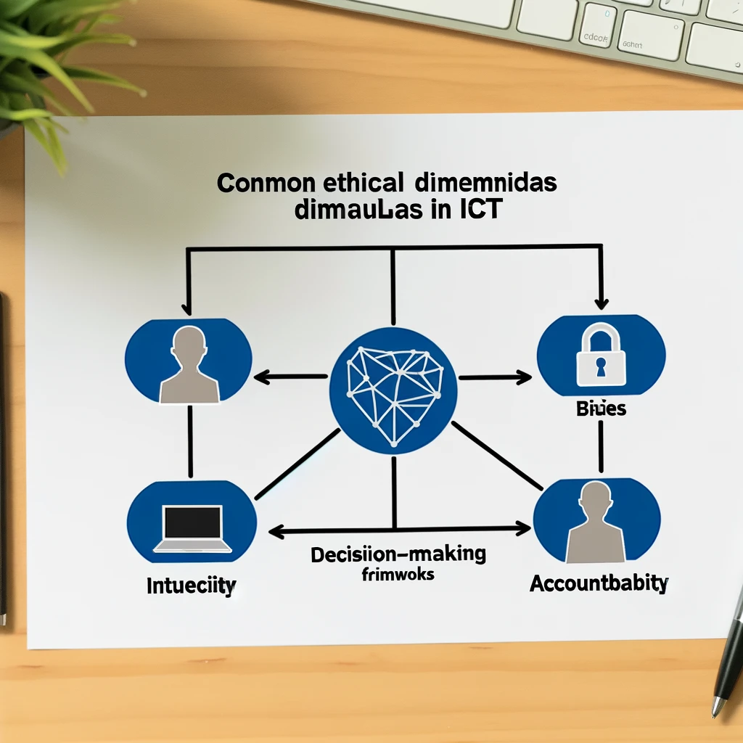
Ethics in ICT
Overview: Ethical frameworks guide ICT professionals through dilemmas such as data breaches and AI bias, emphasizing principles like integrity, privacy, and accountability.
Overview: ICT professionals often encounter ethical dilemmas in their work. Ethical frameworks and codes of conduct help navigate these challenges, ensuring responsible use of technology and consideration of societal impacts.

Slide 19

Privacy and Data Protection
Importance: Data privacy laws, such as GDPR, establish standards for handling personal information, emphasizing the protection and rights of individuals and the responsibilities of organizations.
Importance: In the digital age, protecting personal and sensitive information is paramount. Laws and regulations, such as the General Data Protection Regulation (GDPR), set standards for data privacy and security.

Slide 20

Intellectual Property
Basics: Intellectual property rights protect the creations of the mind in ICT, including copyrights, patents, and trademarks, safeguarding innovation and ensuring creators receive recognition and benefits.
Basics: Understanding intellectual property rights, including copyrights, patents, and trademarks, is essential in ICT to protect creative works and innovations, ensuring recognition and economic benefits for creators.

Slide 21
Emerging Trends
Emerging Trends in ICT encompasses the latest developments and innovations in technology, such as AI, blockchain, and IoT, and their implications for the ICT sector, including new challenges and opportunities for professionals.

Slide 22
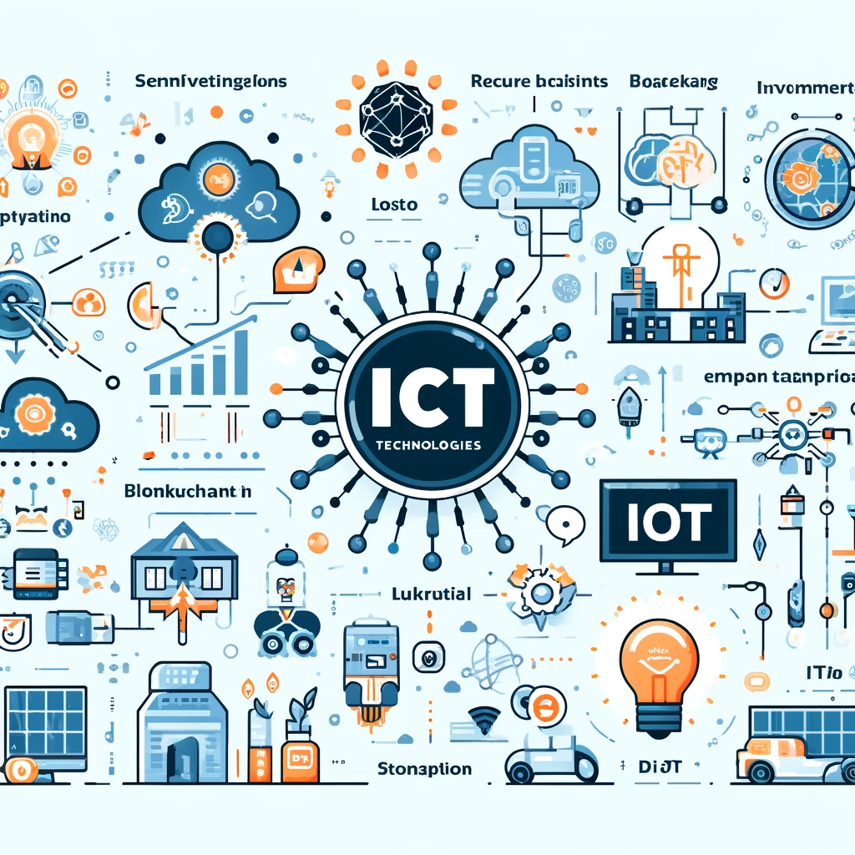
Innovation and Technology Trends
Overview: Emerging technologies like AI, blockchain, and IoT are transforming ICT practices, offering new possibilities for innovation and addressing challenges.
Overview: The ICT sector is constantly evolving with emerging technologies like Artificial Intelligence (AI), Blockchain, and the Internet of Things (IoT). These technologies are reshaping ICT practices, opening new avenues for innovation, and presenting new challenges and opportunities.

Slide 23

Sustainable ICT Practice
Incorporating Sustainability: Sustainability in ICT focuses on energy efficiency, reducing e-waste, and adopting green computing practices to minimize environmental impact.
Incorporating Sustainability: As environmental concerns grow, there's a significant push towards making ICT practices more sustainable. This includes optimizing energy use, reducing electronic waste, and considering the environmental impact of ICT projects.

Slide 24

Globalization
Impact on ICT: Globalization requires ICT professionals to manage cross-cultural communication, adhere to global standards, and leverage ICT to connect markets worldwide.
Impact on ICT: Globalization has made ICT more interconnected than ever, requiring professionals to manage cross-cultural communication effectively and adhere to global ICT standards. This ensures that products and services are accessible and relevant across different cultures and regions.

Slide 25
Professional Development
Professional Development in ICT refers to the continuous learning and career advancement activities undertaken by ICT professionals, including acquiring new skills, earning certifications, networking, and engaging in lifelong learning to stay current in the field.

Slide 26

Career Planning
Overview: Effective career planning in ICT involves setting clear goals, assessing skills, exploring career options, and developing strategies for advancement. It's a dynamic process that adapts to industry changes and personal growth.
Overview: Career planning in ICT involves identifying potential career paths, setting short-term and long-term professional goals, and developing strategies for career advancement. It's about understanding the industry landscape, evaluating personal strengths and interests, and making informed decisions to navigate through various career stages.

Slide 27

Networking
Importance: Networking plays a crucial role in ICT professional development, offering opportunities for learning, collaboration, and career advancement through conferences, professional organizations, and online communities.
Importance: Professional networking is crucial for career development in ICT. Attending conferences, joining professional organizations, and engaging in online communities can lead to new opportunities, mentorship, and collaborations. Networking helps professionals stay informed about industry trends, share knowledge, and gain support from peers.

Slide 28
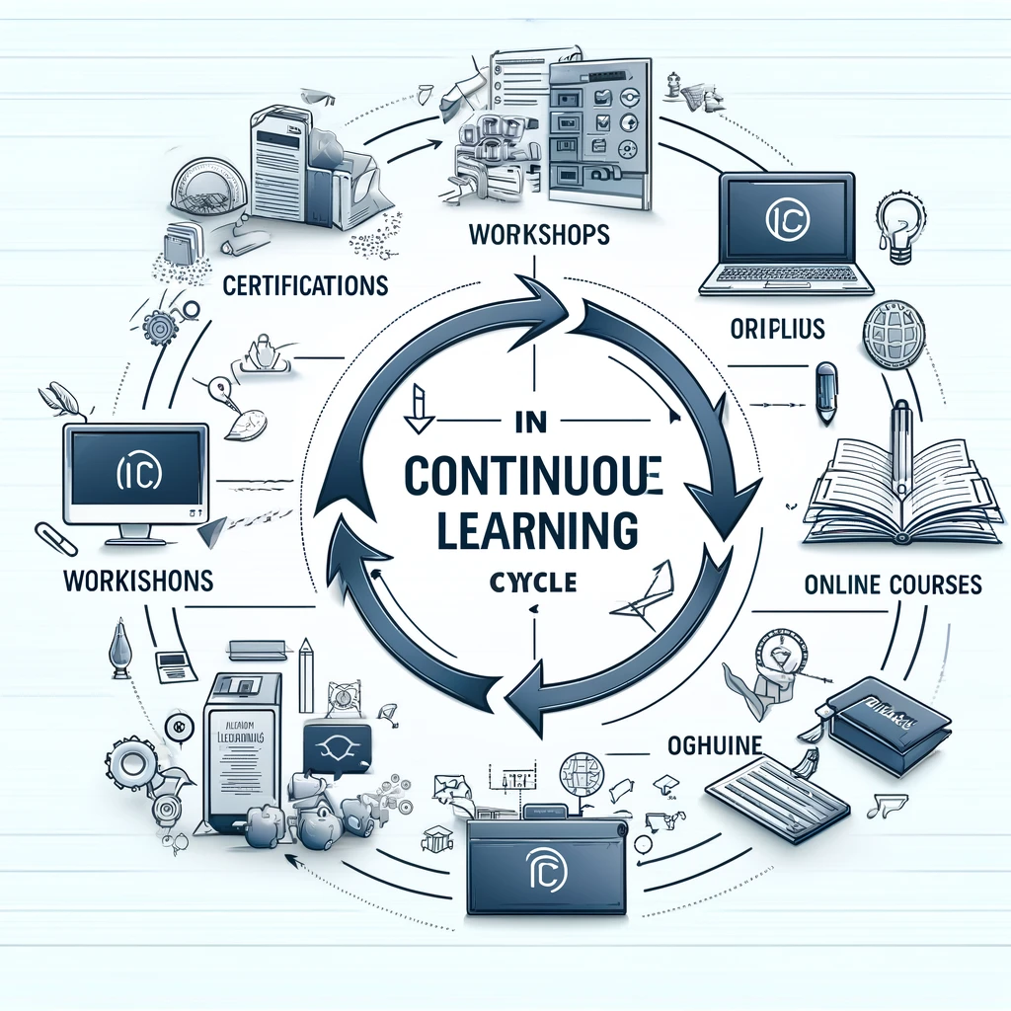
Continuous Learning
Approaches: The ICT field requires a commitment to lifelong learning, with continuous education through certifications, workshops, and advanced degrees being key to keeping up with technological advancements and advancing one's career.
Approaches: The field of ICT is dynamic, with rapid technological advancements. Lifelong learning through certifications, workshops, seminars, and further education is essential to keep skills up-to-date and remain competitive in the job market. Continuous learning also opens up new career opportunities and pathways for professional growth.

